Slide 1
KIET GROUP OF INSTITUTIONS INTERNSHIP PPT
MLSA KIET
FULL STACK WEB DEV

Slide 2
CS SEC 3B
NAME-HARSH VARDHAN ROLL-2300290120106
Building a Simple Calculator: A Step-by-Step Guide Using HTML, CSS, and JavaScript

Slide 3
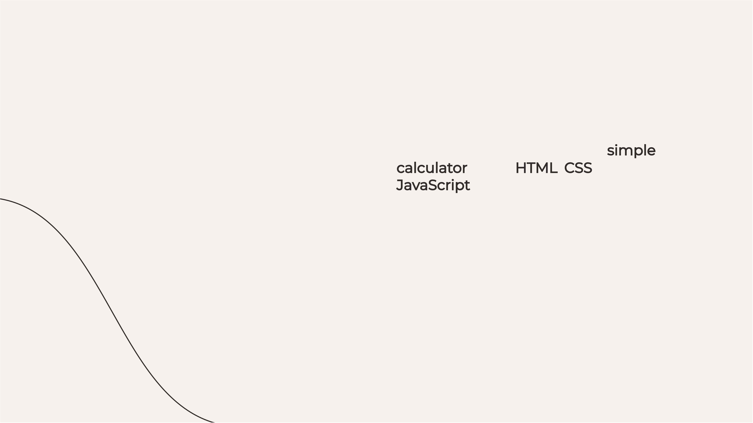

Introduction to Calculator
In this guide, we will create a simple calculator using HTML, CSS, and JavaScript. This project will help you understand the basics of web development and how these technologies work together to create interactive applications. Let's get started on building your ﬁrst web-based calculator!

Slide 4

Setting Up HTML Structure
First, we will create the HTML structure for our calculator. This includes deﬁning the layout with input ﬁelds for numbers and buttons for operations. A well-structured HTML document is crucial for ensuring that our calculator functions properly and is user-friendly.

Slide 5
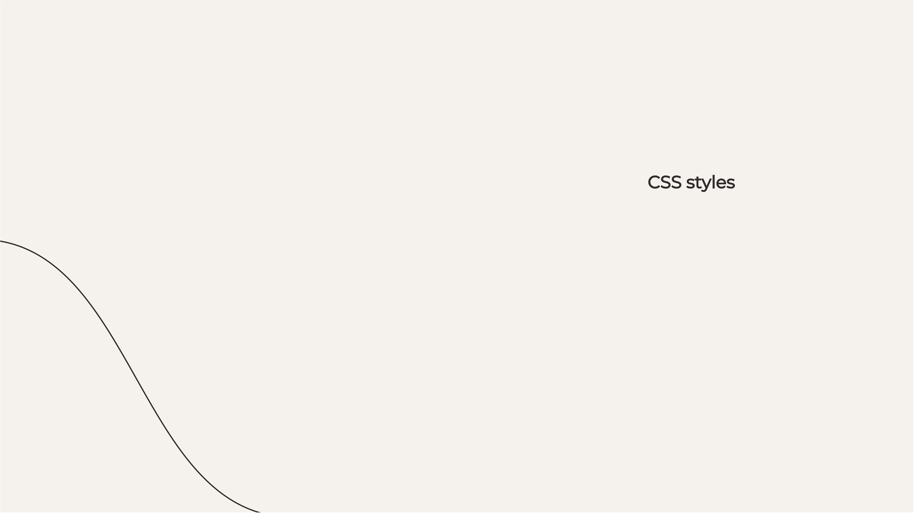

Styling with CSS
Next, we will apply CSS styles to enhance the appearance of our calculator. This step involves setting colors, fonts, and spacing to make the calculator visually appealing. Proper styling improves user experience and makes the application more engaging.

Slide 6



Adding JavaScript Functionality
Finally, we will implement JavaScript to add functionality to our calculator. This includes handling user input, performing calculations, and displaying results.
Understanding JavaScript is key to making your web applications interactive and dynamic .

Slide 7
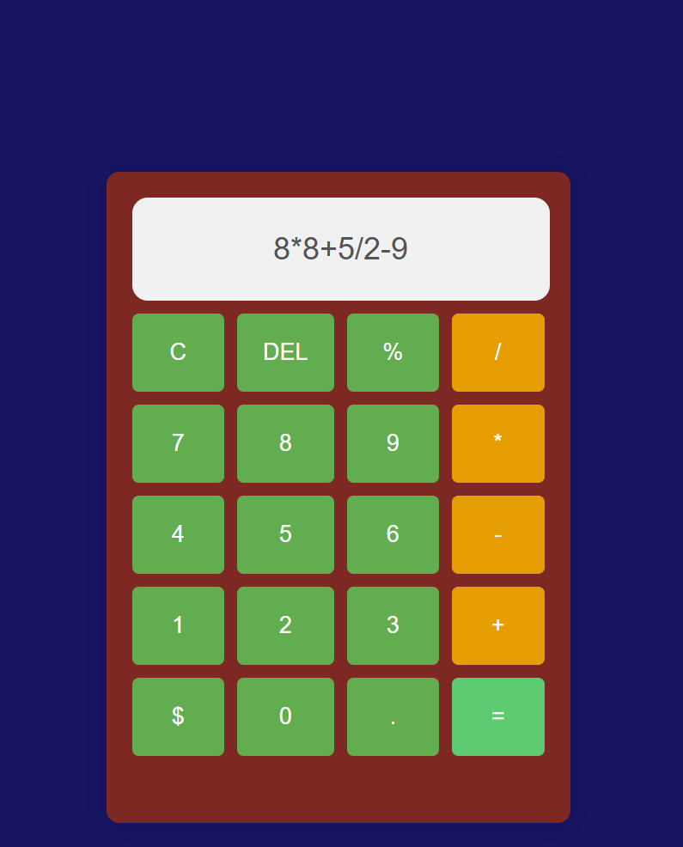
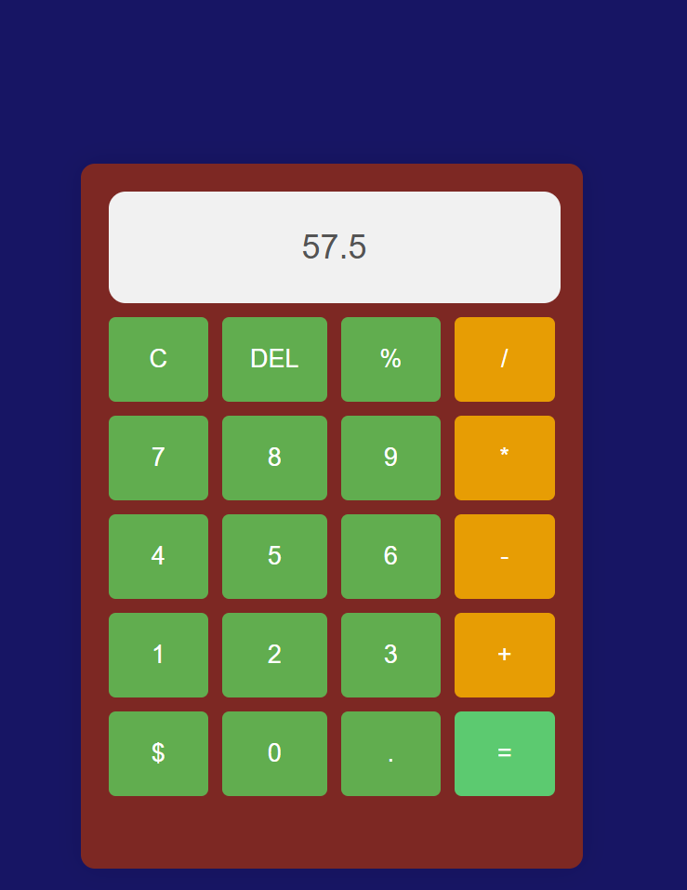

Slide 8


Conclusion
In conclusion, we have successfully built a simple calculator using HTML, CSS, and JavaScript. This project not only enhances your coding skills but also provides a solid
foundation for more
complex web applications. Keep practicing and
exploring new features!

Slide 9

Thanks!

